Slide 1
SS ZG 526: Distributed Computing
Distributed Mutual Exclusion (DME)
Chittaranjan Hota
Professor, Dept. of Computer Sc. & Information Systems
BITS, Pilani Hyderabad Campus, Hyderabad
hota@hyderabad.bits-pilani.ac.in

Slide 2
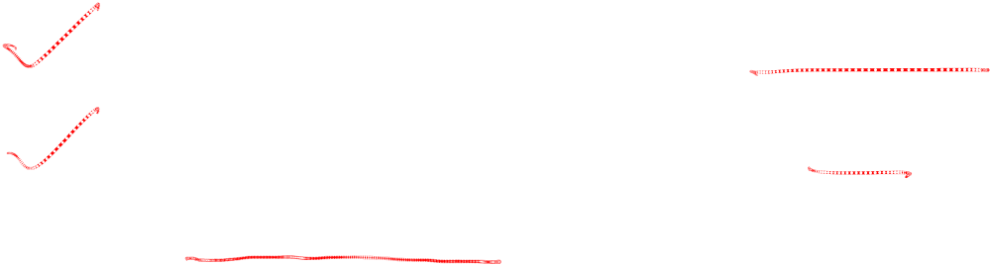
Distributed Mutual Exclusion
What is mutual exclusion?
Simultaneous update and read of a directory/file
2. Can two processes send their data to a printer?
So, it is exclusive access to a shared resource or to the critical region.
Birla Institute of Technology and Science, Pilani (Deemed University)

Slide 3
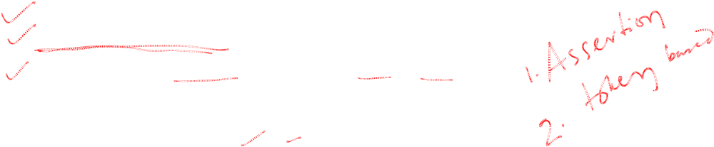
Performance of DME Algorithms
Performance of each algorithm is measured in terms of
- no. of messages required for CS invocation
- synchronization delay (leaving & entering)
- response time (arrival, sending out, Entry & Exit)
System throughput = 1/(sd + E)
Birla Institute of Technology and Science, Pilani (Deemed University)

Slide 4
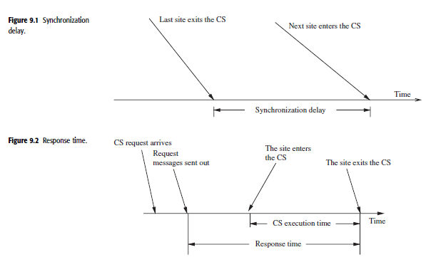
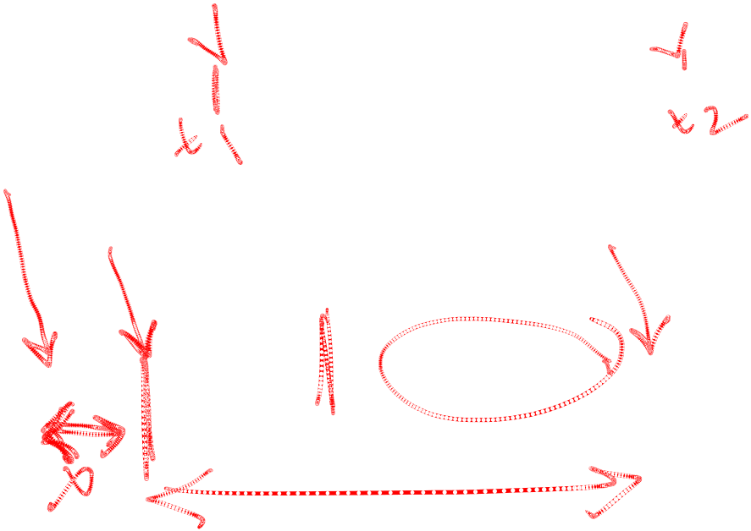
Continued…
Birla Institute of Technology and Science, Pilani (Deemed University)

Slide 5
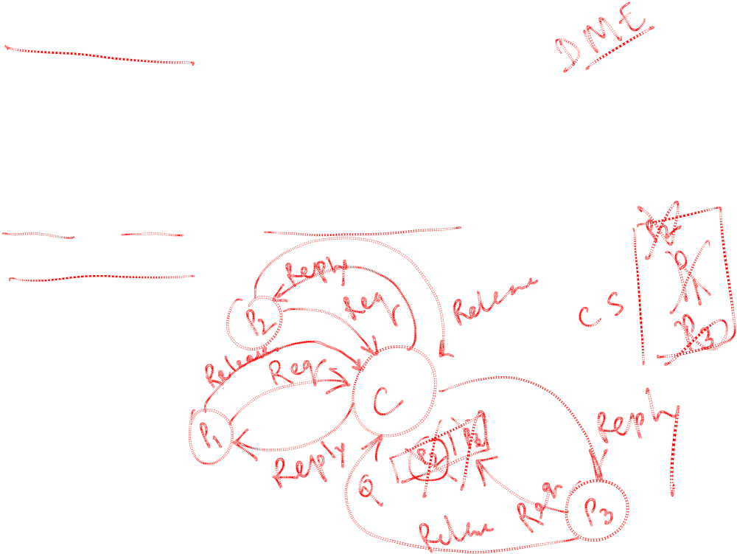
A Centralized Algorithm
A Central controller with a queue for deferring replies.
Request, Reply, and Release messages.
Reliability and Performance bottleneck.
Birla Institute of Technology and Science, Pilani (Deemed University)

Slide 6
Next session
Lamports’ DME
Birla Institute of Technology and Science, Pilani (Deemed University)

